Slide 1

Reference Points 101
Robyn Forrest and Tim Barrett
Nov 15 and 22, 2022
Technical Expertise in Stock Assessment (TESA) Webinar

Slide 2
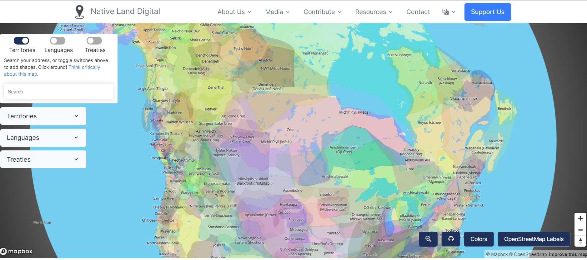
https://native-land.ca/

Slide 3
Objectives
This webinar comes after the 2021 joint TESA/National Operational Guidelines (NOG) Taskforce workshop on “Limit Reference Points and the Fish Stocks Provisions”.
Feedback from the workshop indicated a desire for more training in the theory and calculation of reference points.
This webinar tries to address this gap by focusing on the more technical aspects of calculating reference points.
Participants are invited to review the materials from the 2021 workshop for a deeper dive into considerations for selecting LRPs
https://github.com/TESA-workshops/LRP
The proceedings from the 2021 workshop will be published as a DFO Technical Report

Slide 4
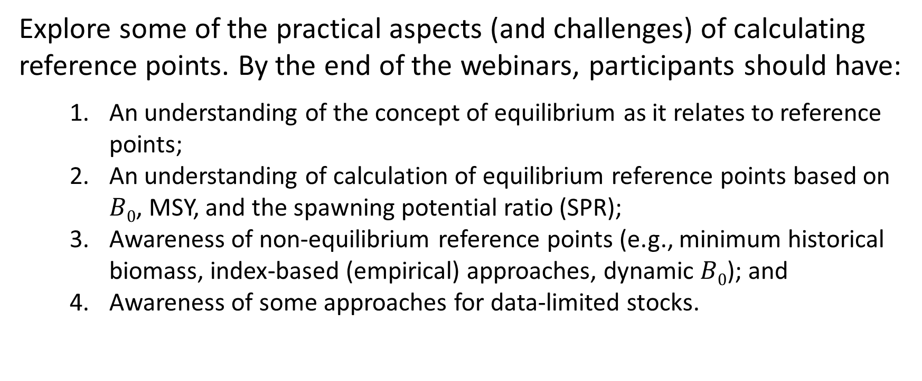
Objectives
Explore some of the practical aspects (and challenges) of calculating reference points. By the end of the webinars, participants should have:
An understanding of the concept of equilibrium as it relates to reference points;
An understanding of calculation of equilibrium reference points based on $B0$, MSY, and the spawning potential ratio (SPR);
Awareness of non-equilibrium reference points (e.g., minimum historical biomass, index-based (empirical) approaches, dynamic $B0$); and
Awareness of some approaches for data-limited stocks.
Last week
This week

Slide 5
Outline – Day 2
Discussion of exercises
Non-equilibrium reference points
Brief introduction to time-varying reference points
Exercise 5
Approaches for data-limited stocks
Closed-loop simulation
Questions
Objective here is to make you aware of these things and not to cover them in detail

Slide 6
1. Discussion of Exercises

Slide 7
2. Non-equilibrium Reference Points

Slide 8
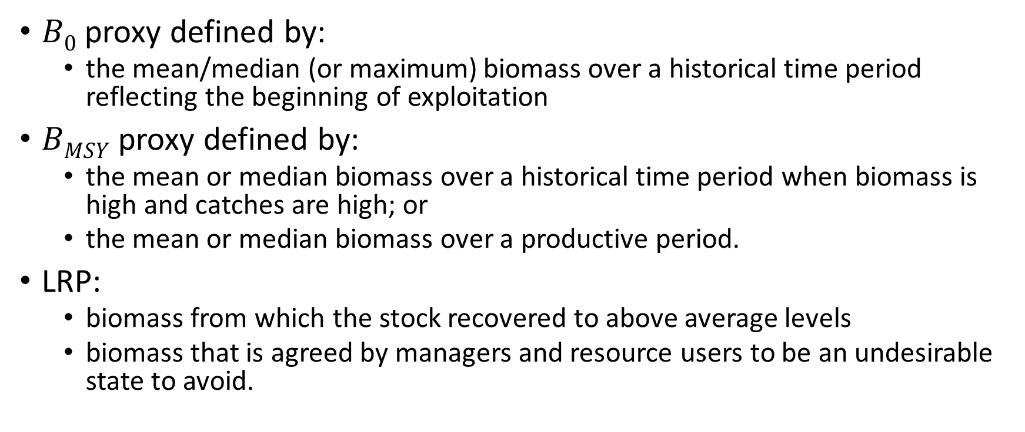
Reference Points based on Historical Biomass
$B0$ proxy defined by:
the mean/median (or maximum) biomass over a historical time period reflecting the beginning of exploitation
$BMSY$ proxy defined by:
the mean or median biomass over a historical time period when biomass is high and catches are high; or
the mean or median biomass over a productive period.
LRP:
biomass from which the stock recovered to above average levels
biomass that is agreed by managers and resource users to be an undesirable state to avoid.

Slide 9
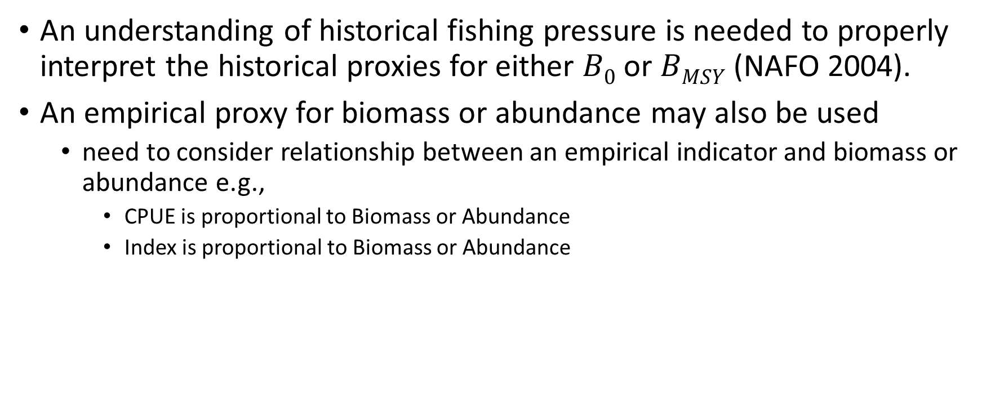
Reference Points based on Historical Biomass
An understanding of historical fishing pressure is needed to properly interpret the historical proxies for either $B0$ or $BMSY$ (NAFO 2004).
An empirical proxy for biomass or abundance may also be used
need to consider relationship between an empirical indicator and biomass or abundance e.g.,
CPUE is proportional to Biomass or Abundance
Index is proportional to Biomass or Abundance
NAFO (Northwest Atlantic Fisheries Organization) 2004. Report of the NAFO Study Group on Limit Reference Points. NAFO SCS Doc. 04/12, Serial No. N4980.

Slide 10
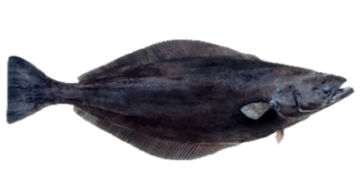
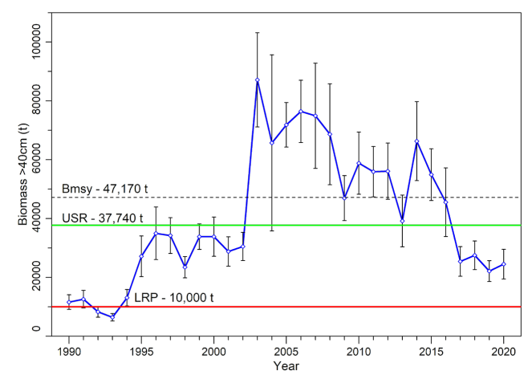
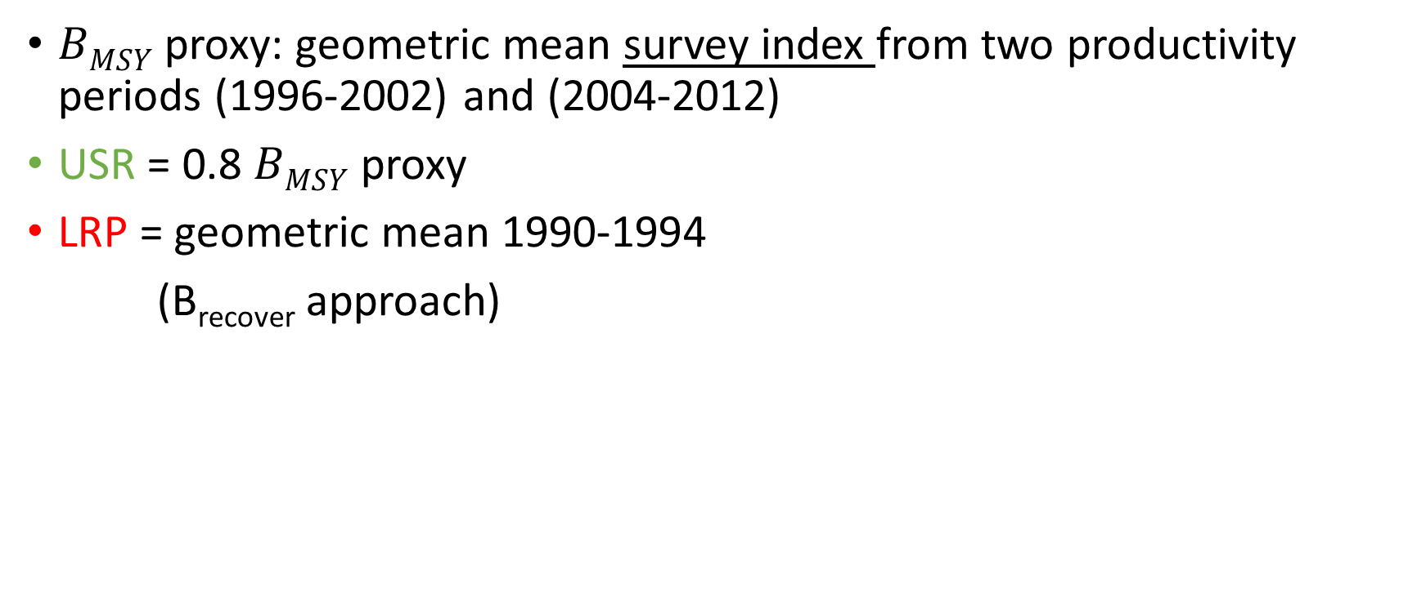
4RST Greenland halibut
$BMSY$ proxy: geometric mean survey index from two productivity periods (1996-2002) and (2004-2012)
USR = 0.8 $BMSY$ proxy
LRP = geometric mean 1990-1994
(B_{recover} approach)
DFO. 2021. Assessment of the Gulf of St. Lawrence (4RST) Greenland halibut stock in 2020. DFO SAR 2021/017.

Slide 11
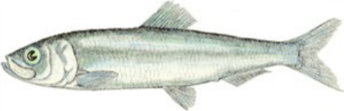
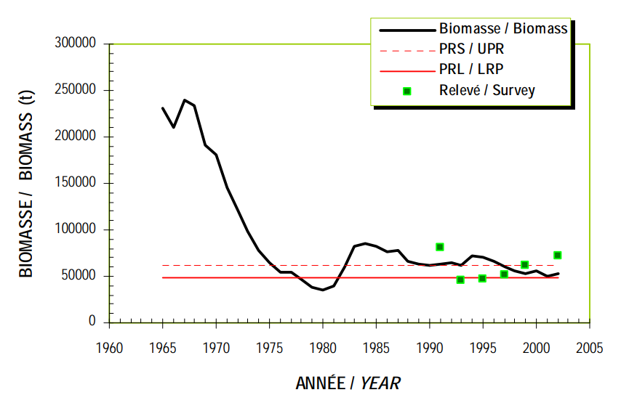
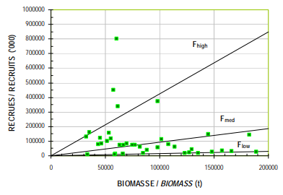
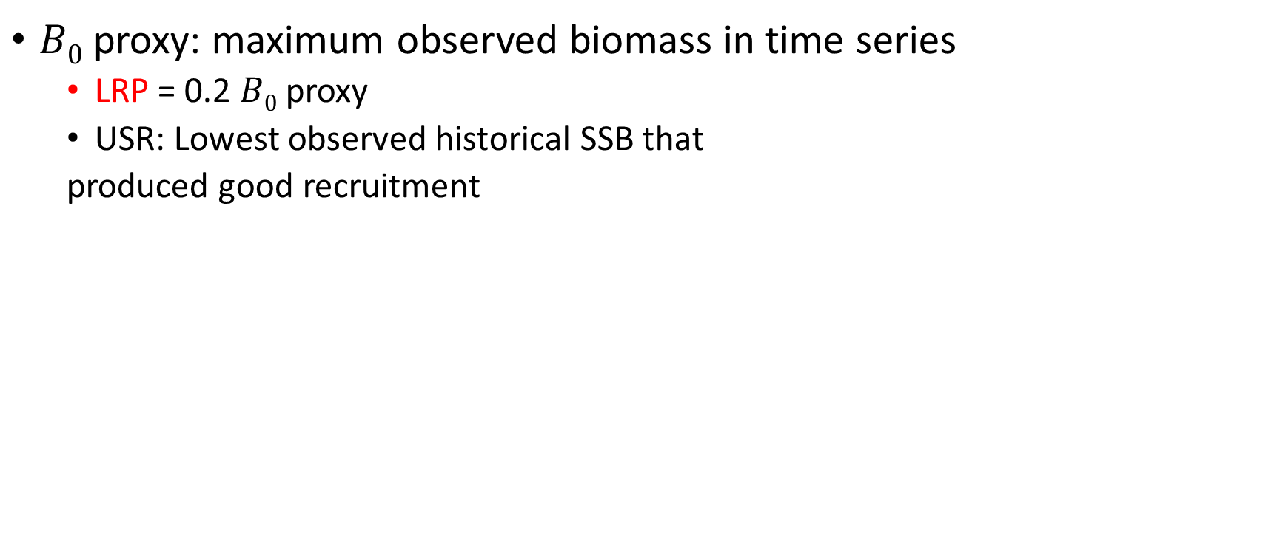
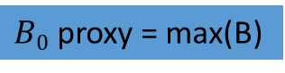
4R Fall spawning Atlantic herring
$B0$ proxy: maximum observed biomass in time series
LRP = 0.2 $B0$ proxy
USR: Lowest observed historical SSB that
produced good recruitment
$B0$ proxy = max(B)
Grégoire, F., and McQuinn, I.H. 2010. Reference points and harvest strategy framework for the Atlantic herring (Clupea harengus harengus) fishery of the west coast of Newfoundland (NAFO Division 4R). DFO Res Doc. 2010/099.

Slide 12

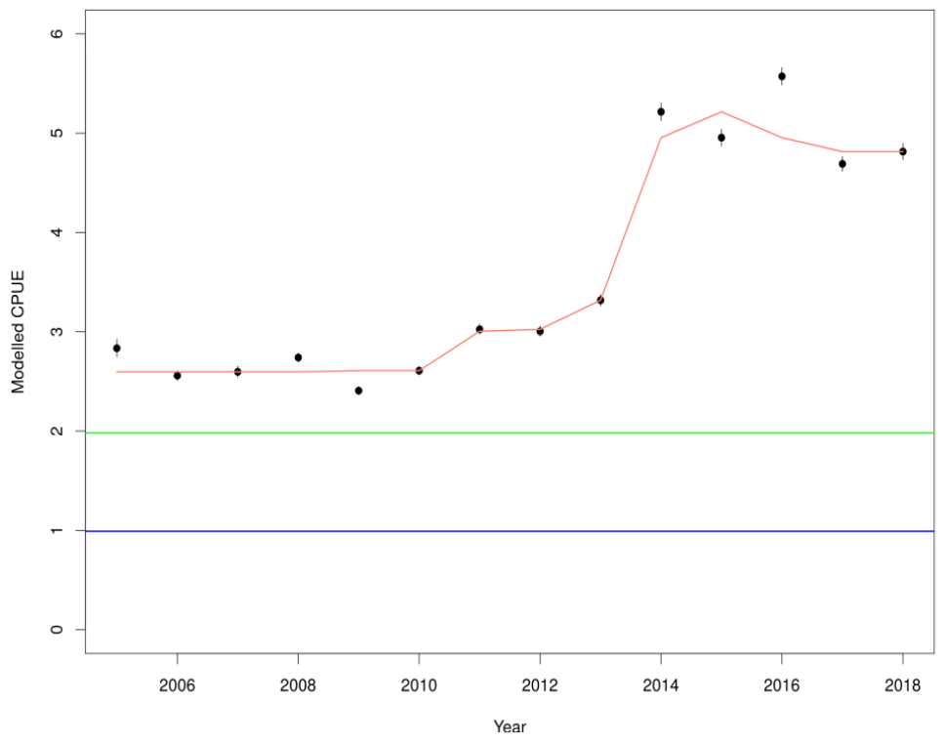
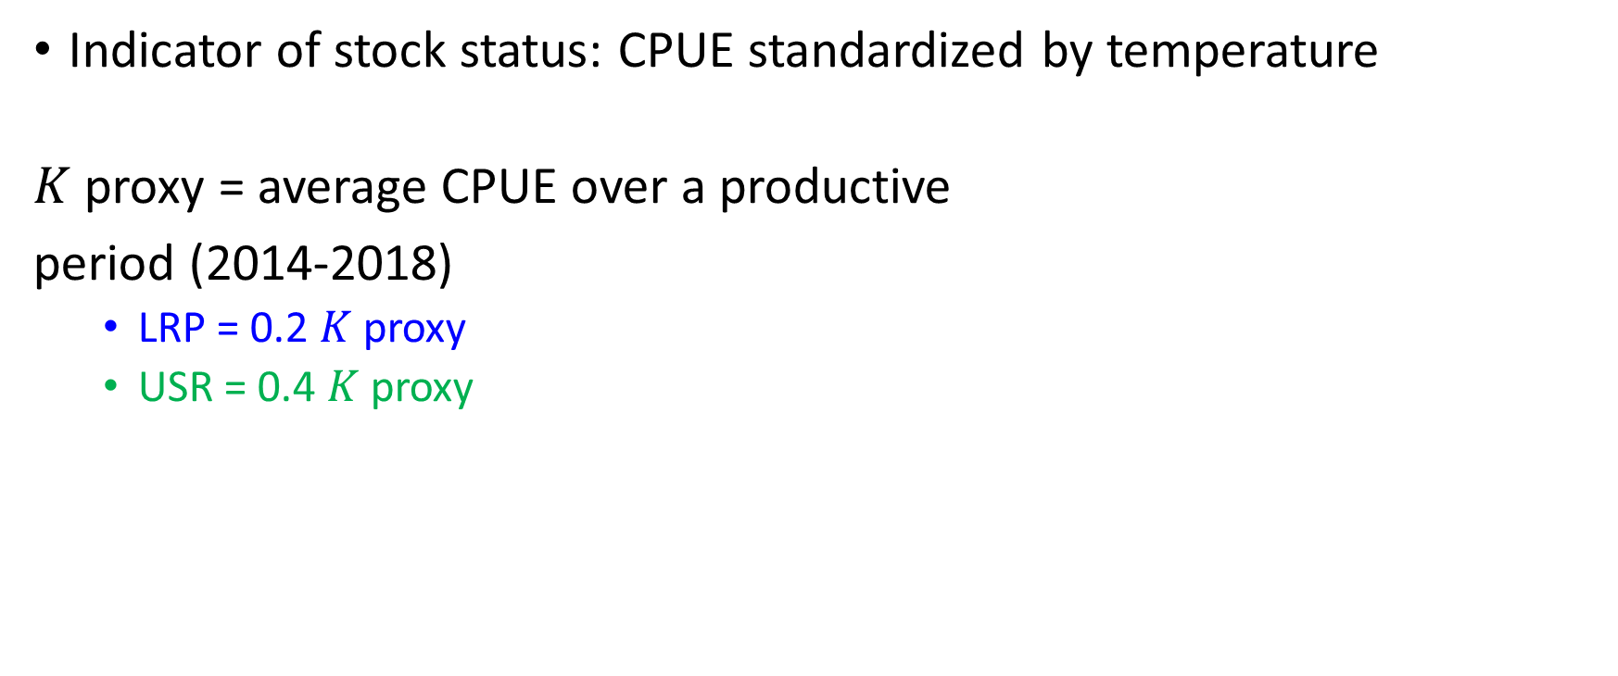
American Lobster (LFA 38)
Indicator of stock status: CPUE standardized by temperature
$K$ proxy = average CPUE over a productive
period (2014-2018)
LRP = 0.2 $K$ proxy
USR = 0.4 $K$ proxy
Cook, A.M., Hubley, B., Howse, V., and Denton, C. In press. 2019 Framework Assessment of the American Lobster (Homarus americanus) in LFA 34–38. DFO Res. Doc.
DFO. 2022. Stock status update of lobster (Homarus americanus) in lobster fishing areas 36 and 38. DFO Science Response. 2022/006.

Slide 13
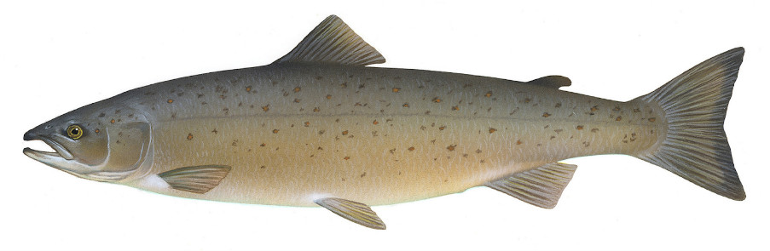
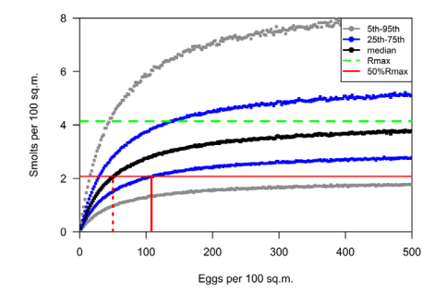
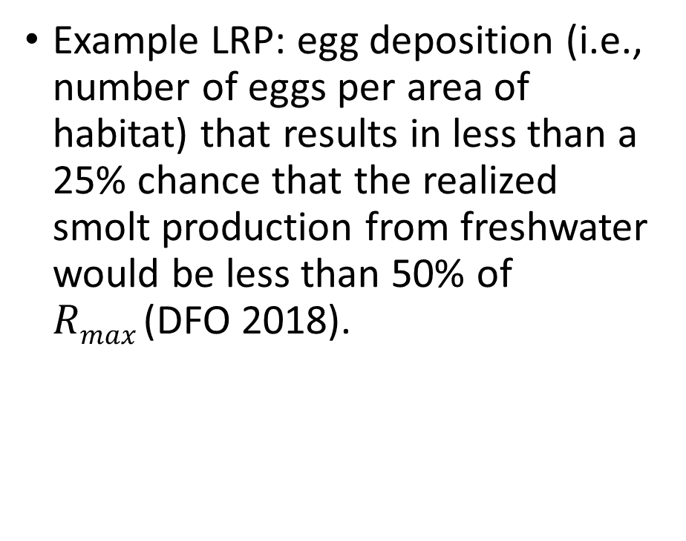
Atlantic salmon
Example LRP: egg deposition (i.e., number of eggs per area of habitat) that results in less than a 25% chance that the realized smolt production from freshwater would be less than 50% of $Rmax$(DFO 2018).
DFO. 2018. Limit reference points for Atlantic salmon rivers in DFO Gulf region. DFO Can. Sci. Advis. Sec. Sci. Advis. Rep. 2018/015.

Slide 14
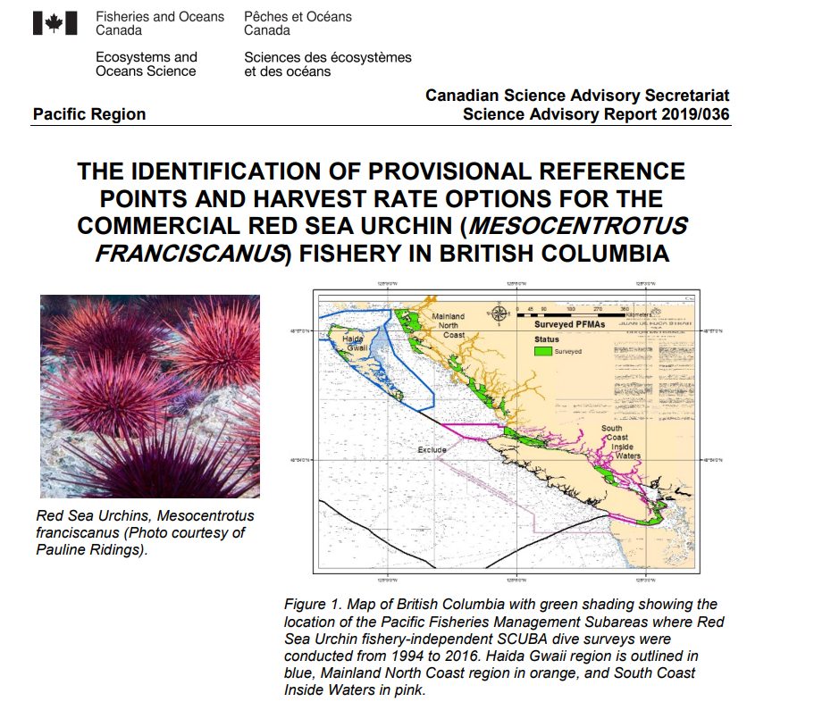
Pacific Red Sea Urchin (RSU)
Empirical approach based on RSU density estimates in Sea Otter-inhabited areas (areas where Sea Otters have been present for several years may indicate the highest harvesting pressure under which biologically viable RSU populations can be maintained)
Recommended LRP: 0.3 mature RSU/m² on RSU habitat
Recommended USR: 0.6 mature RSU/m² on RSU habitat

Slide 15
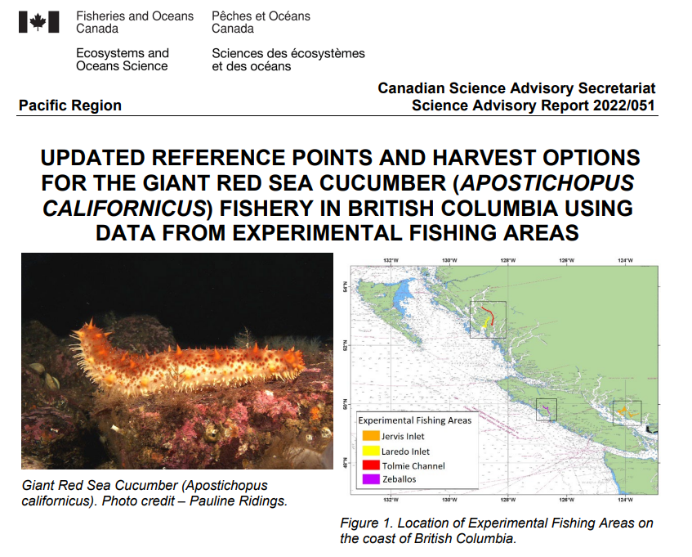
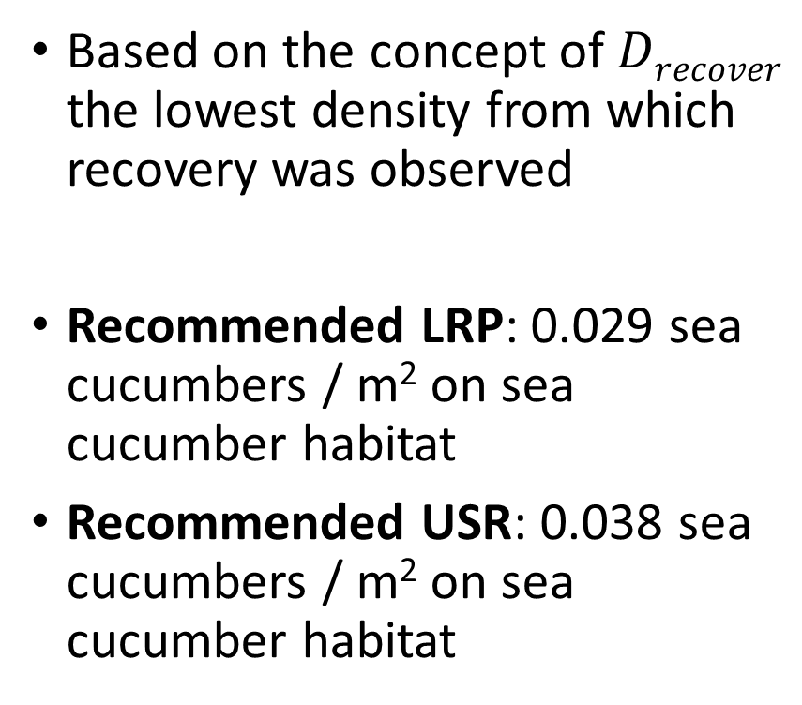
Pacific Giant Red Sea Cucumber
Based on the concept of $Drecover$ the lowest density from which recovery was observed
Recommended LRP: 0.029 sea cucumbers / m² on sea cucumber habitat
Recommended USR: 0.038 sea cucumbers / m² on sea cucumber habitat

Slide 16
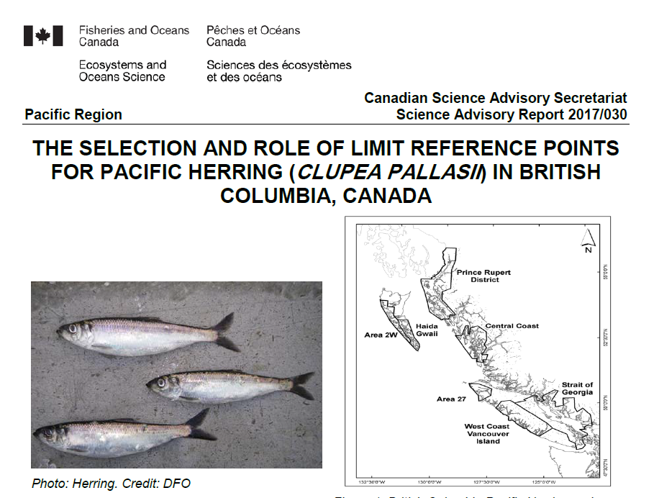
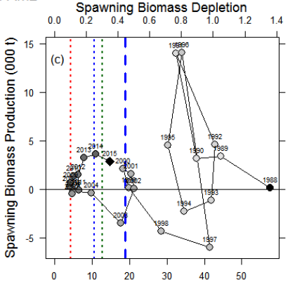
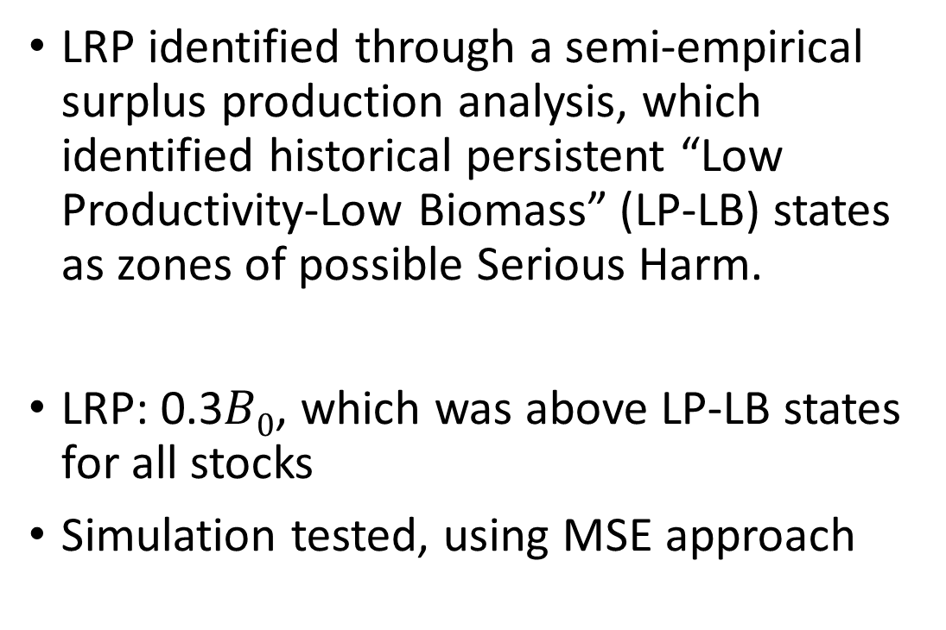
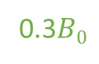
Pacific Herring (5 stocks)
LRP identified through a semi-empirical surplus production analysis, which identified historical persistent “Low Productivity-Low Biomass” (LP-LB) states as zones of possible Serious Harm.
LRP: 0.3$B0$, which was above LP-LB states for all stocks
Simulation tested, using MSE approach
0.3$B0$

Slide 17
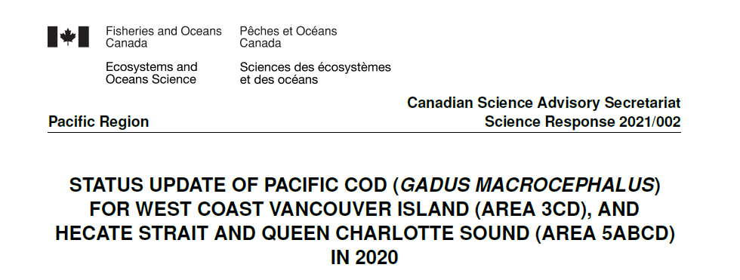
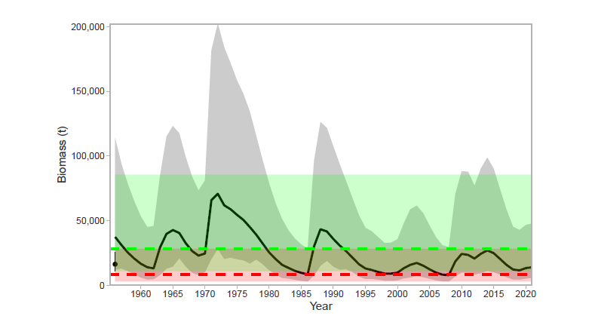
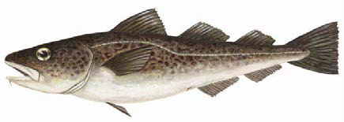
Pacific cod - WCVI
LRP: An agreed upon low historical biomass state to be avoided (Estimated 1986 biomass)
USR: Mean of estimated historical biomass (1956:2004)

Slide 18
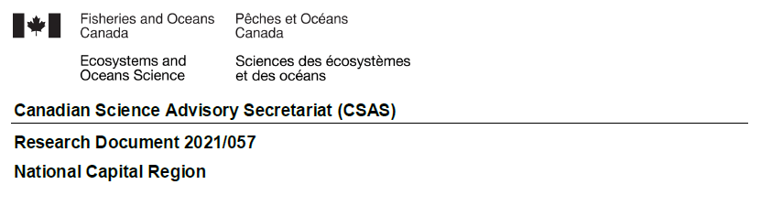
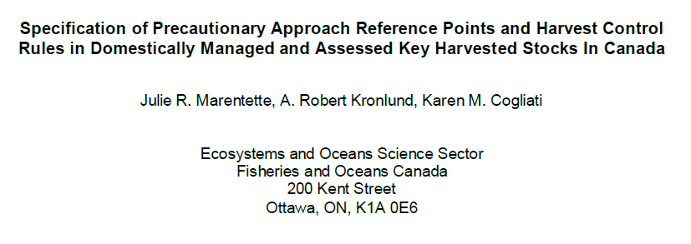
More Examples

Slide 19
3. Brief Intro to Time-varying Reference Points

Slide 20
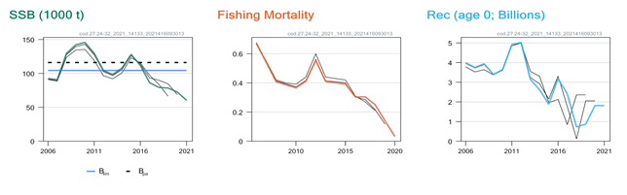
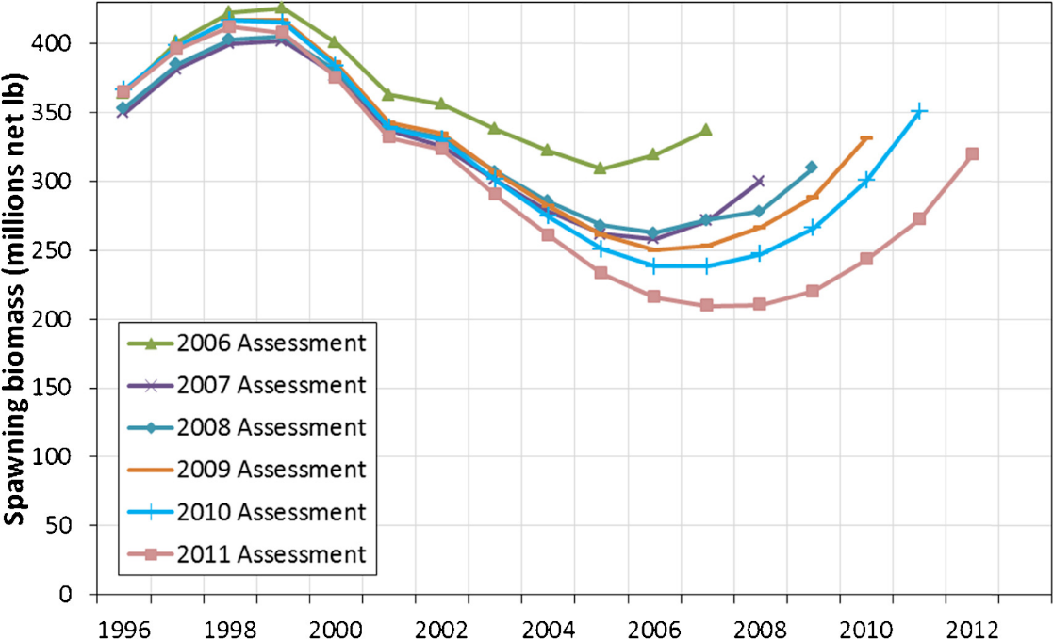
Stock assessments change over time
As assessments are updated, new data often lead to slight or large changes in parameter estimates over time
When retrospective patterns are large, we may need to explicitly account for time-varying processes in stock assessment
Stewart, I. J., & Martell, S. J. D. 2014. Fisheries Research, 158: 40-49.

Slide 21

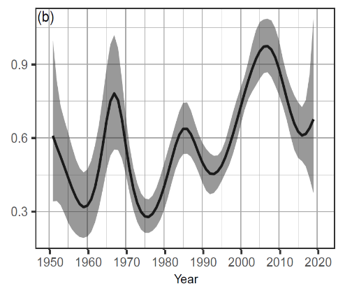

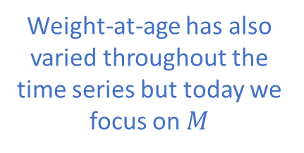
Time-varying natural mortality ($M$)
Case Study: West Coast Vancouver Island (WCVI) Pacific Herring
Weight-at-age has also varied throughout the time series but today we focus on $M$
DFO. 2020. Stock status update with application of management procedures for Pacifc Herring (Clupea pallasii) in British Columbia: Status in 2019 and forecast for 2020. DFO Can. Sci. Advis. Sec. Sci. Resp. 2020/004.

Slide 22

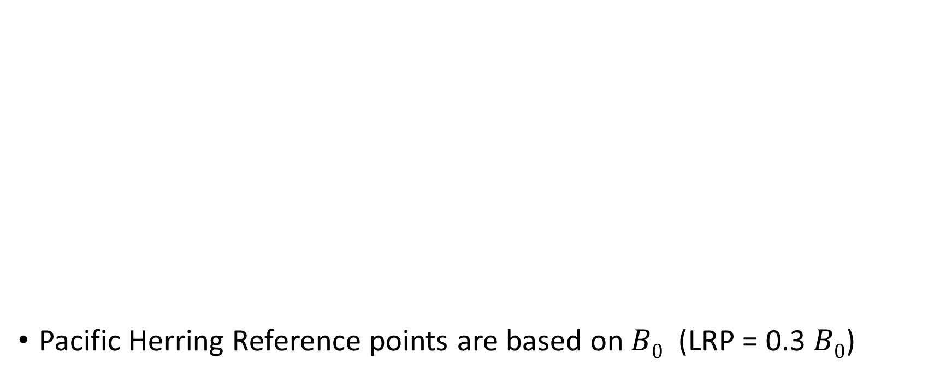
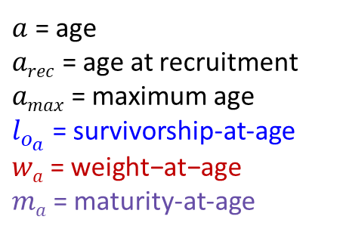
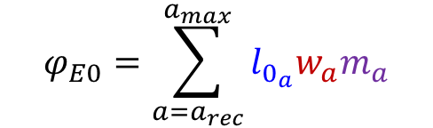
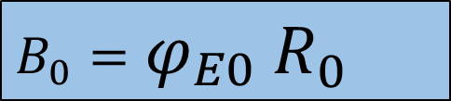
Equilibrium reference points and changing productivity
Unfished equilibrium recruitment
Pacific Herring Reference points are based on $B0$ (LRP = 0.3 $B0$)
$$B0$$
$$φ_{E0}=\sum_{{a=a}_{rec}}^{a_{max}}{l_{0_{a}}w_{a}m_{a}}$$
$B_{0}=φ_{E0}$ $R_{0}$
$a$ = age
$arec$ = age at recruitment
$amax$ = maximum age
$l_{o_{a}}$ = survivorship-at-age
$$wa\text{ = }\text{weight}\text{−}\text{at}\text{−}\text{age}$$
$ma$ = maturity-at-age
Unfished equilibrium SSB
Unfished SSB-per-recruit (eggs-per-recruit)

Slide 23
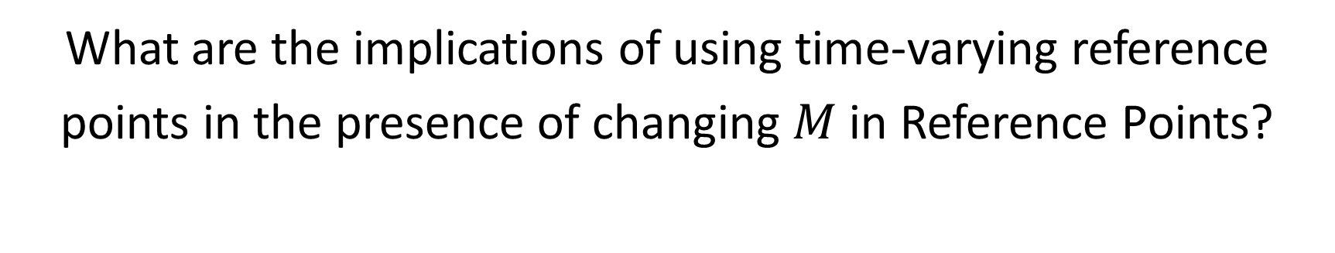
Question
What are the implications of using time-varying reference points in the presence of changing $M$ in Reference Points?
This is a work in progress closed loop simulation case study implemented in openMSE with Quang Huynh (Blue Matter Science Ltd)

Slide 24
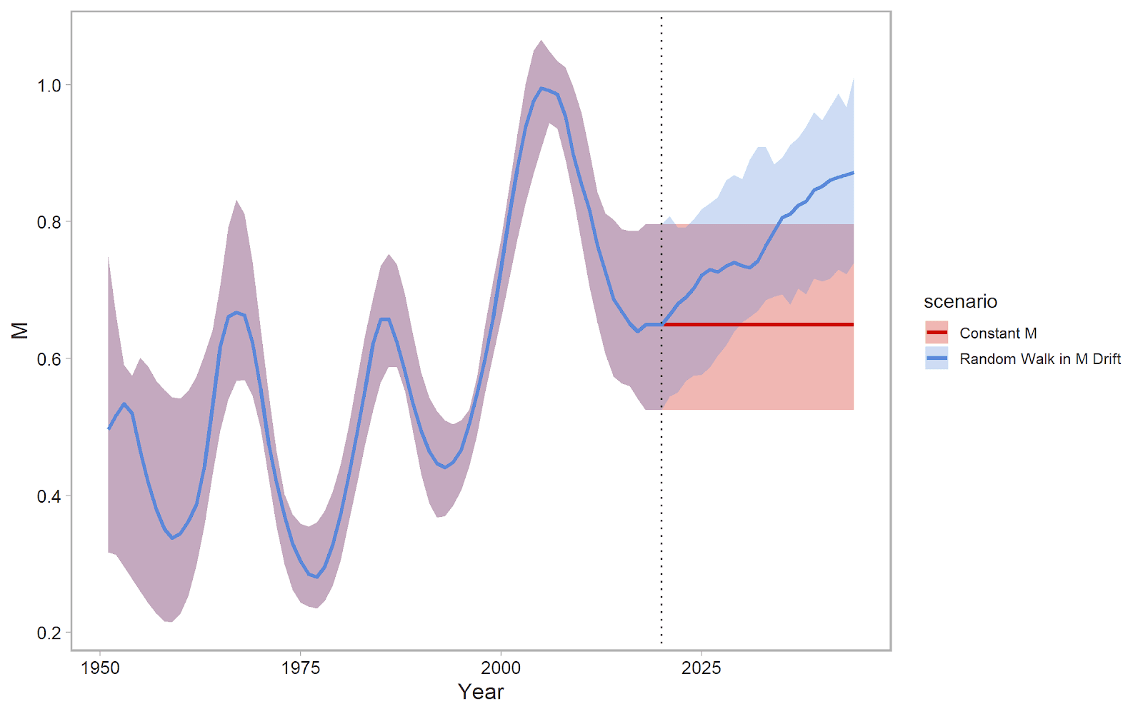

$M$ scenarios
West Coast Vancouver Island (WCVI)
Two alternative hypotheses (scenarios) for future M
M constant after 2019
M increasing after 2019 (random walk with upward drift)

Slide 25
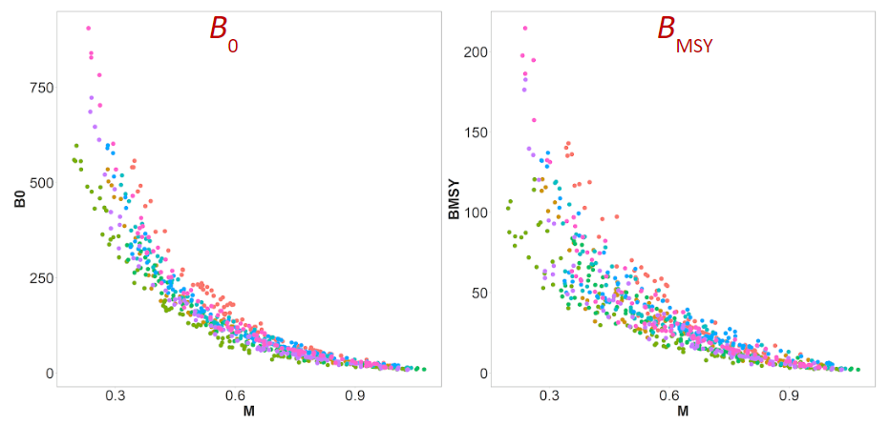

Inverse relationship between $M$ and key equilibrium reference points

Slide 26
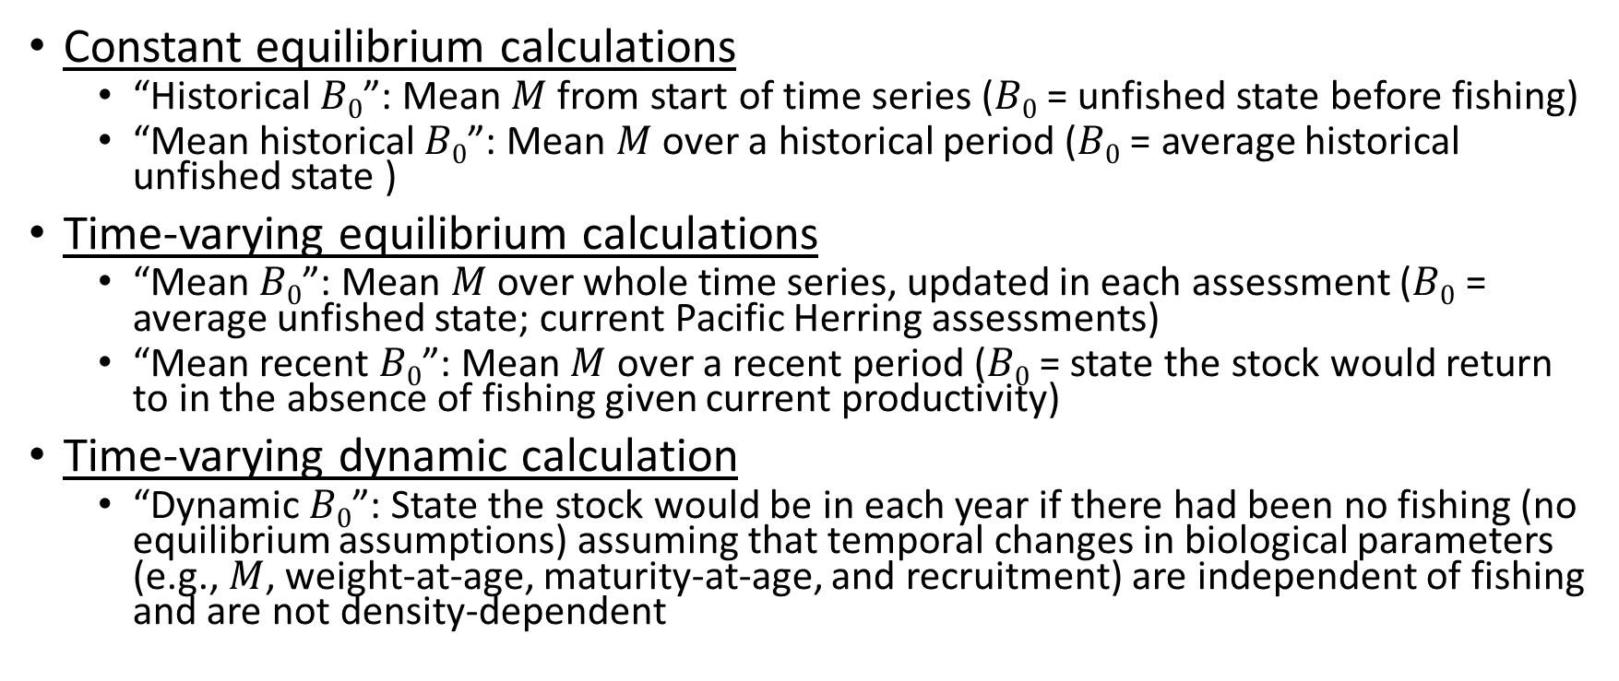

Examples: $B0$ five ways
Constant equilibrium calculations
“Historical $B0$”: Mean $M$ from start of time series ($B0$ = unfished state before fishing)
“Mean historical $B0$”: Mean $M$ over a historical period ($B0$ = average historical unfished state )
Time-varying equilibrium calculations
“Mean $B0$”: Mean $M$ over whole time series, updated in each assessment ($B0$ = average unfished state; current Pacific Herring assessments)
“Mean recent $B0$”: Mean $M$ over a recent period ($B0$ = state the stock would return to in the absence of fishing given current productivity)
Time-varying dynamic calculation
“Dynamic $B0$”: State the stock would be in each year if there had been no fishing (no equilibrium assumptions) assuming that temporal changes in biological parameters (e.g., $M$, weight-at-age, maturity-at-age, and recruitment) are independent of fishing and are not density-dependent

Slide 27
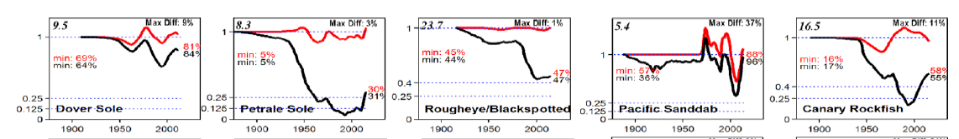

Dynamic $B0$^{1,2}
Theoretical state of the stock in each year in the absence of fishing
Run the stock assessment with all data to get parameter estimates
Rerun without catch data, assuming the same annual parameter estimates
Assumes all biological states, especially recruitment deviations, would have been the same with or without fishing
Visualization of the impact of fishing over the stock’s history (dynamic B₀ in red)
Figure 3. Berger, A.M. 2019. Character of temporal variability in stock productivity influences the utility of dynamic reference points. Fisheries Research, 217: 185-197
1. Berger, A. M. (2019). Character of temporal variability in stock productivity influences the utility of dynamic reference points. Fisheries Research, 217, 185–197. https://doi.org/10.1016/j.fishres.2018.11.028
2. MacCall, A.D., Klingbeil, R.A., and Methot, R.D. 1985. Recent increased abundance and potential productivity of Pacific mackerel (Scomber japonicus). CalCOFI Reports, XXVI, 119-129.

Slide 28
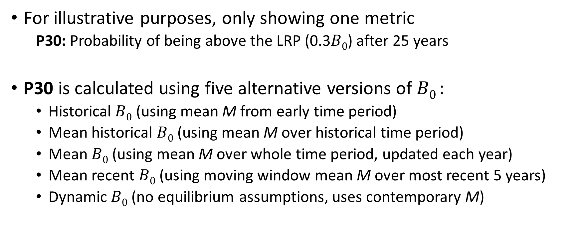
Performance Metrics
For illustrative purposes, only showing one metric
P30: Probability of being above the LRP (0.3$B0$) after 25 years
P30 is calculated using five alternative versions of $B0$:
Historical $B0$ (using mean M from early time period)
Mean historical $B0$ (using mean M over historical time period)
Mean $B0$ (using mean M over whole time period, updated each year)
Mean recent $B0$ (using moving window mean M over most recent 5 years)
Dynamic $B0$ (no equilibrium assumptions, uses contemporary M)

Slide 29
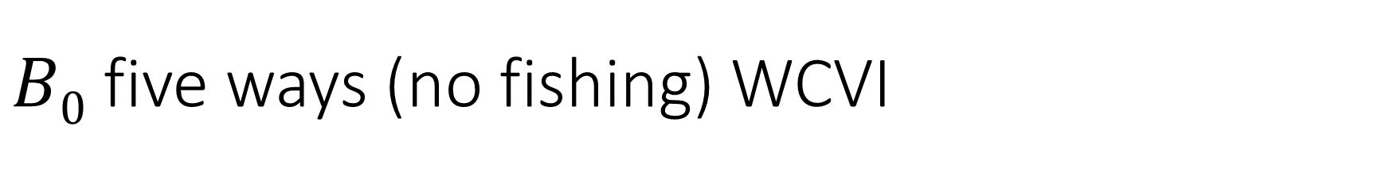

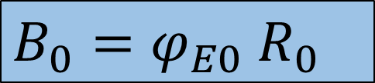
$B0$ five ways (no fishing) WCVI
M
$B_{0}=φ_{E0}$ $R_{0}$
$$φ_{E0}=\sum_{{a=a}_{rec}}^{a_{max}}{l_{0_{a}}w_{a}m_{a}}$$
M goes into survivorship function
Hist.
Mean Hist.
Mean
Mean recent
Dynamic

Slide 30
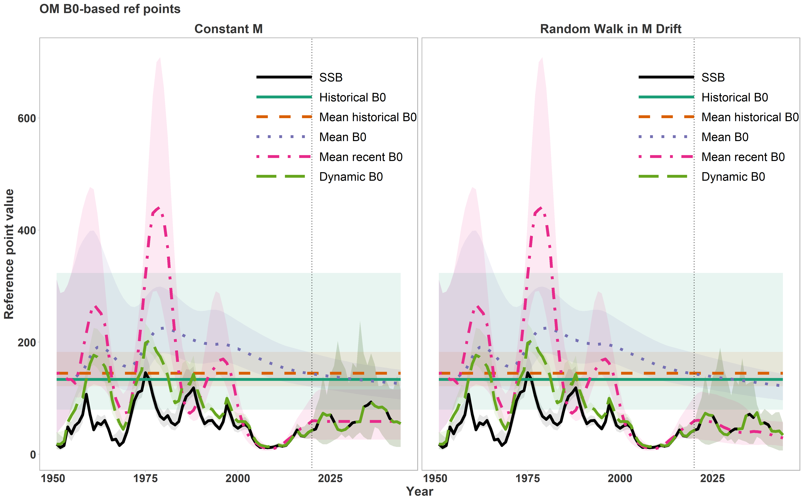
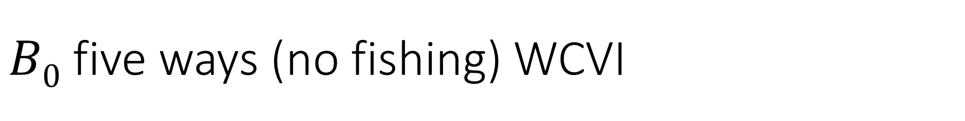
$B0$ five ways (no fishing) WCVI
Constant M
Increasing M

Slide 31
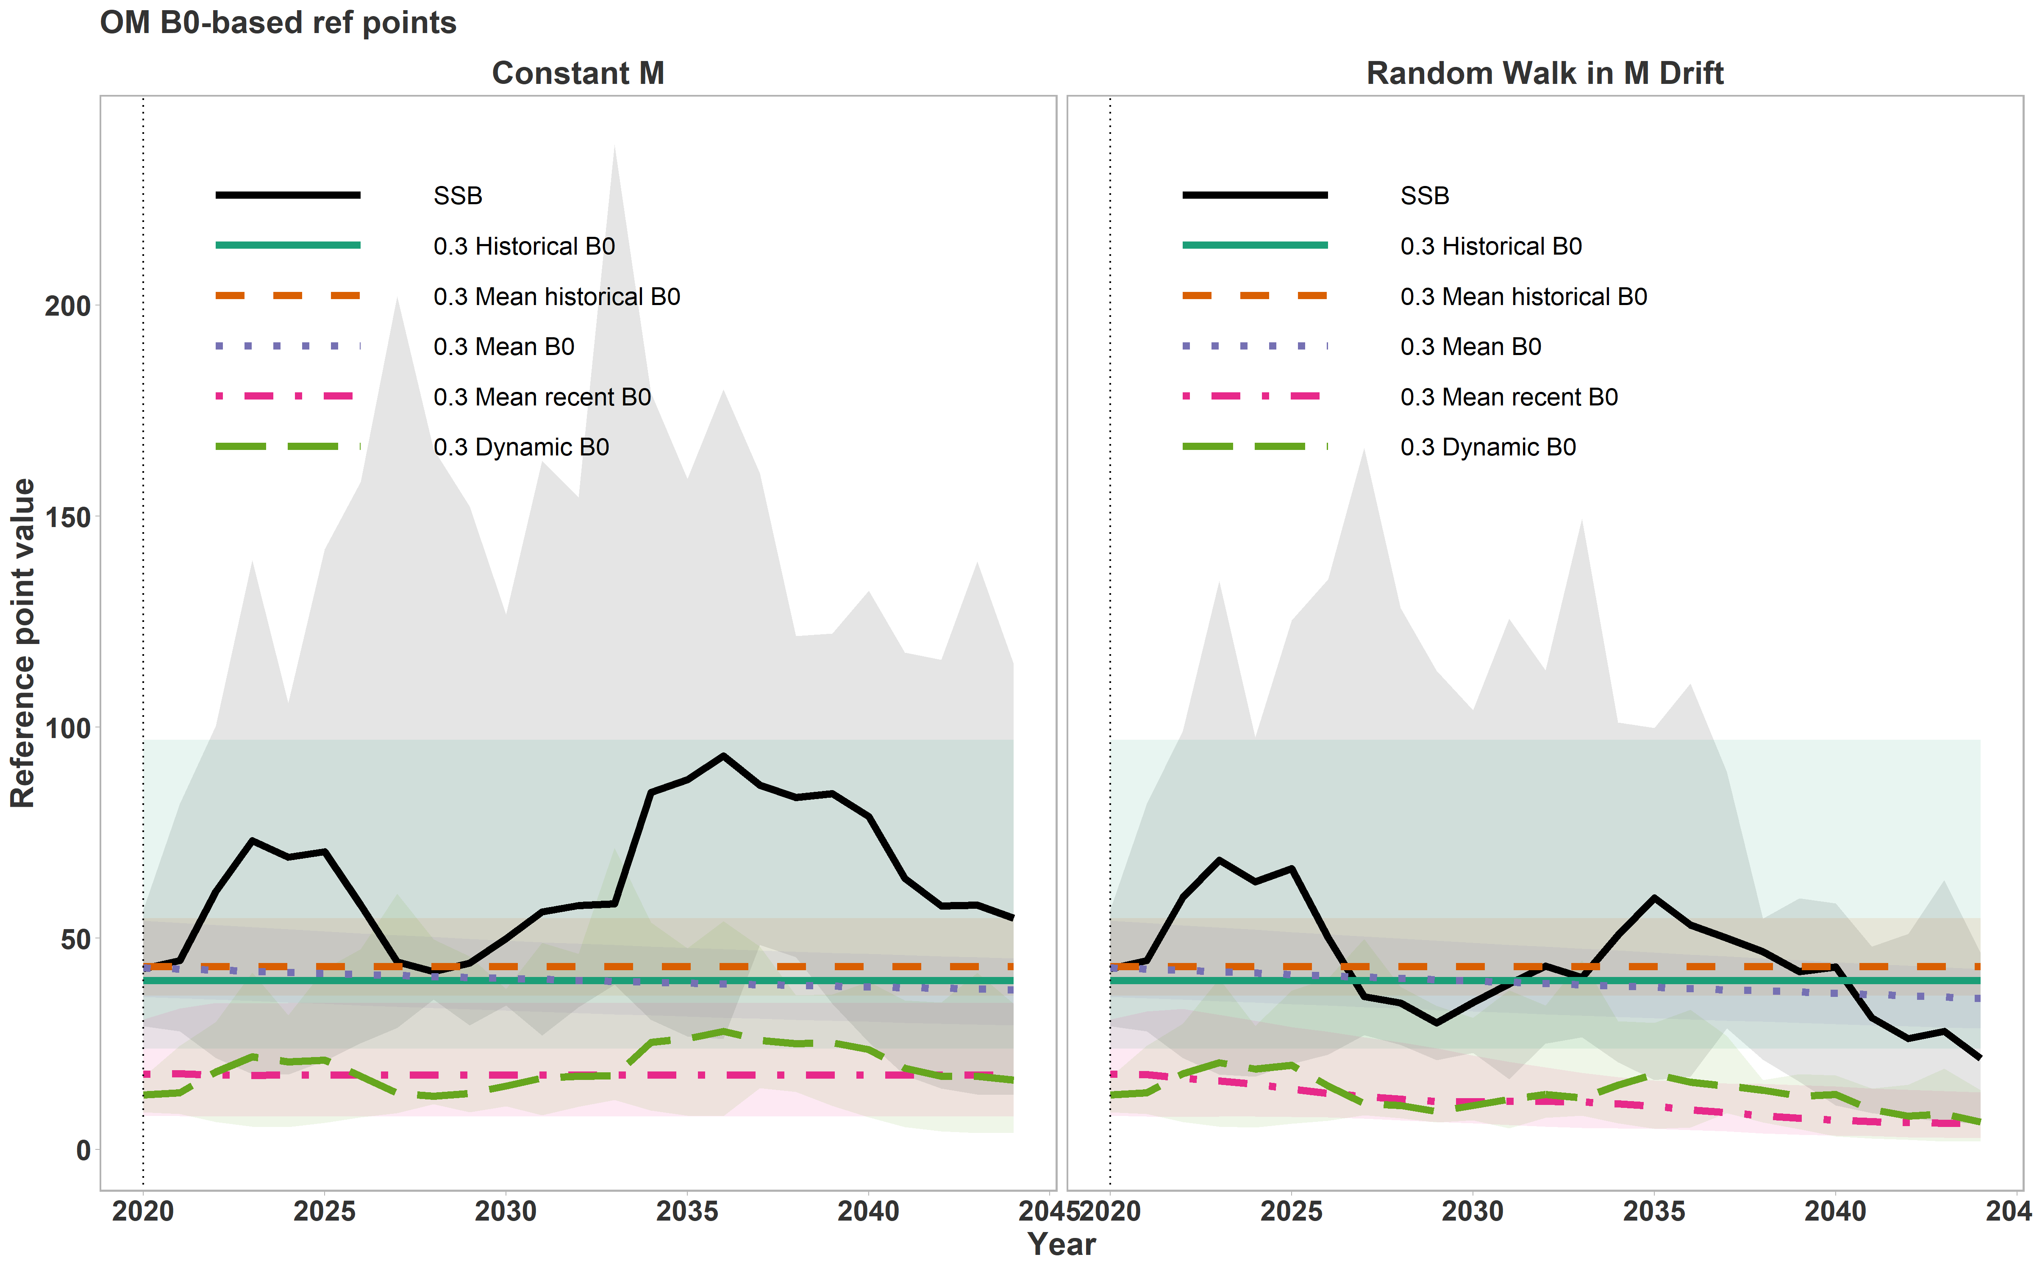
Projected LRP five ways (No Fishing)
Constant M
Increasing M
LRP = 0.3B₀

Slide 32
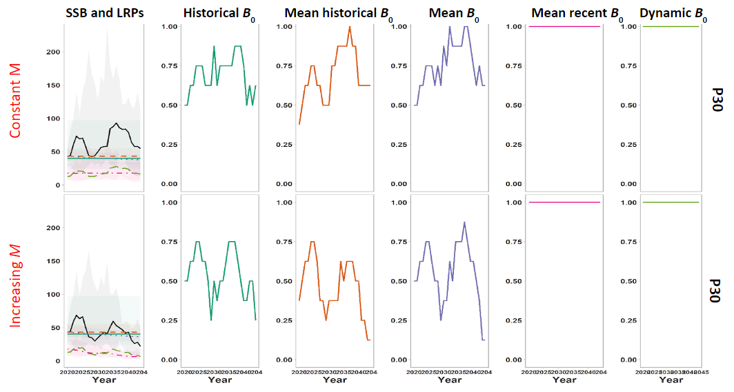
Time-varying LRP (no fishing) WCVI

Slide 33
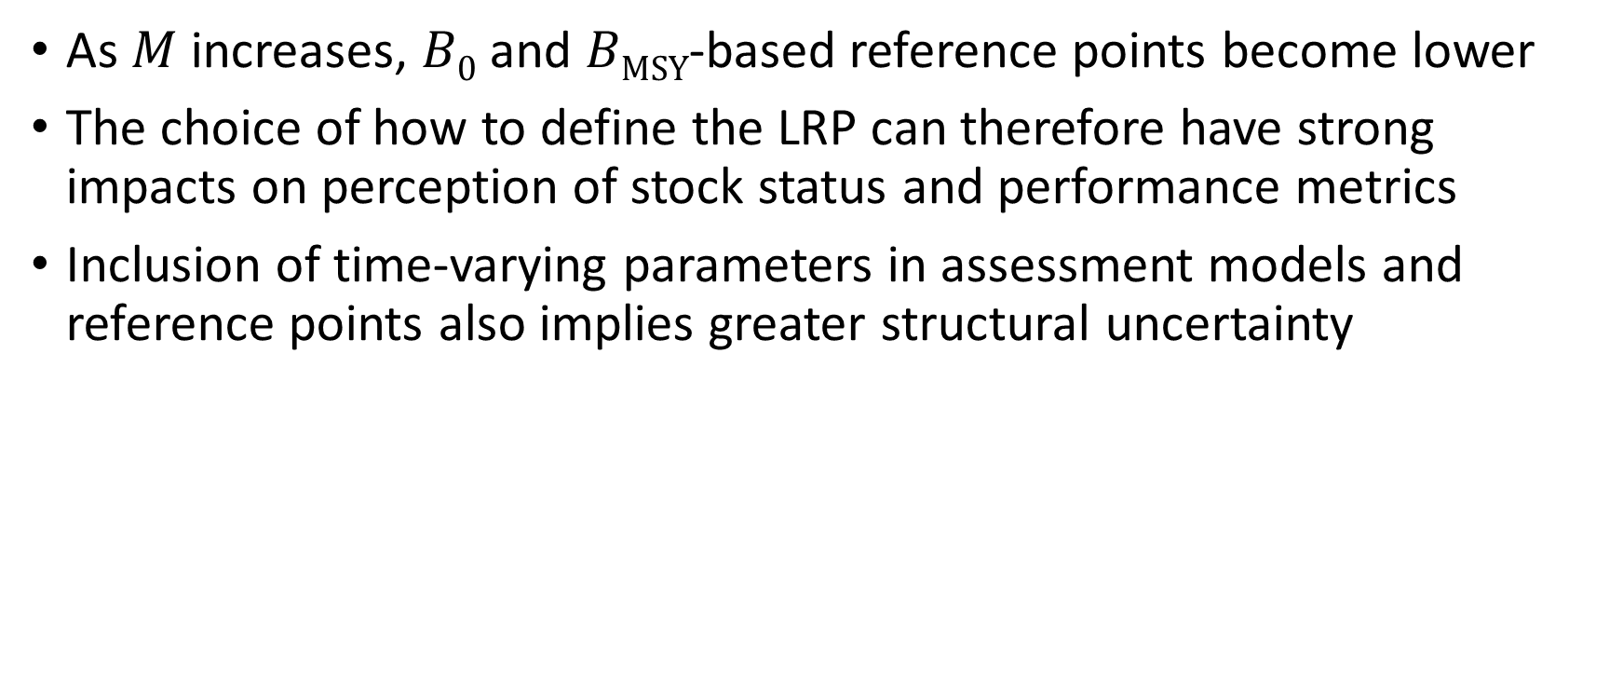
Conclusions
As $M$ increases, $B0$ and $BMSY$-based reference points become lower
The choice of how to define the LRP can therefore have strong impacts on perception of stock status and performance metrics
Inclusion of time-varying parameters in assessment models and reference points also implies greater structural uncertainty

Slide 34

Changing reference points should not solely be the purview of Science
Even though the definition of the LRP is delegated to Science, serious harm is difficult to define and there can be many different defensible definitions of the LRP (and other reference points)
Decisions on changing reference points to account for environmental change represent changes in objectives, and should be made in consultation with managers, First Nations and stakeholders
Frequent changes to reference points can undermine confidence in the decision-making process^{1,2}
1. Collie, J. S., Bell, R. J., Collie, S. B., and Minto, C. 2021. Harvest strategies for climate-resilient fisheries. ICES JMS, 78: 2774-2783.
2. Walters, C. J., and Collie, J. S. 1988. Is research on environmental factors useful to fisheries management? CJFAS, 45: 1848-1854.

Slide 35

Exercise
In Exercise 5, we explore the influence of the choice of time period used to calculate reference points
Exercise 5A looks at time-varying weight-at-age
Exercise 5B looks at time-varying $M$

Slide 36
4. Approaches for Data-limited Stocks

Slide 37

Approaches for Data-limited Stocks
Methods:
Empirical, theoretical, and historical proxies for $B0$ and $BMSY$
Length-based methods
Catch-only methods: can provide estimates of B relative to $B0$ and $BMSY$
Have generally been used to estimate global trends in stock status and not for stock assessment
A number of studies suggest these approaches are prone to bias
Closed-loop simulation approaches: an alternative to using empirical proxies or methods that rely on strong model assumptions or priors

Slide 38

Empirical and Historical Proxies for $B0$ and $BMSY$
Covered on earlier slides. For examples see:

Slide 39


Theoretical Proxies for $BMSY$
Per-recruit models: Spawning Potential Ratio $SPR = φ_{F} /φ_{E0}$
$F$ reference point:
$FX\%SPR$ represents the $F$ that results in X% of unfished SSB-per-recruit
$FX\%SPR$ is a common proxy for $FMSY$
Value of SPR as a proxy for $FMSY$ depends on productivity
Biomass reference points
$BMSY$ proxy = equilibrium B from fishing at $FX\%SPR$
Productivity | r | F_{MSY} ≈ F_{X%SPR}
Very Low | -* | F_{≥50%}
Low | <0.14 | F_{45%}
Medium | 0.14-0.35 | F_{40%}
High | >0.35 | F_{30%}
*Defined based on M < 0.1 and age-at-maturation > 15 years
NZ Ministry of Fisheries (2011)

Slide 40


Theoretical Proxies for $FMSY$
Others $FMSY$ proxies:
$Fmax$ = $F$ that maximizes YPR (not recommended)
$F0.1$ = $F$ where slope of YPR curve is 10% of the slope at the origin
Sensitive to assumptions about growth and $M$
Not recommended without understanding how well it relates to $FMSY$ (Mace 2001)
$FMSY$ = $M$ or a proportion of $M$
$0.87M$meta-analysis (Zhou et al. 2012)
$0.5M$ pelagic species (Patterson 1992)
Biomass reference points = equilibrium B from fishing at $F$
Mace, P.M. 2001. A new role for MSY in single-species and ecosystem approaches to fisheries stock assessment and management. Fish and Fisheries, 2: 2-32.
Patterson, K. 1992. Fisheries for small pelagic species: an empirical approach to management targets. Reviews in Fish Biology and Fisheries, 2: 321-338.
Zhou, S., Yin, S., Thorson, J.T., Smith, A.D., and Fuller, M. 2012. Linking fishing mortality reference points to life history traits: an empirical study. Canadian Journal of Fisheries and Aquatic Sciences, 69: 1292-1301.

Slide 41
Length-based approaches
ICES length-based indicators
Indicator Type | Indicator | Calculation | Reference Point* | Expected Value [Indicator / Reference Point]
Conservation (large individuals) | L_{max5%} | Mean length of largest 5% | L_{inf} | >0.8
 | L_{95%} | 95th Percentile | L_{inf} | >0.8
 | P_{mega} | Proportion of individuals > 1.1 L_{opt} | 0.3 – 0.4 | P_{mega} > 0.3
Conservation (juveniles) | L_{25%} | 25th Percentile | L_{mat} | >1
 | L_{c} | Length at 50% of modal abundance | L_{mat} | >1
Optimal Yield | L_{mean} | Mean length > L_{c} | L_{opt} = 2/3 L_{inf} | ≈1
 | L_{maxy} | Length class with maximum biomass in catch | L_{opt} = 2/3 L_{inf} | ≈1
MSY | L_{mean} | Mean length > L_{c} | L_{F=M} = 0.75 L_{c} + 0.25 L_{inf} | ≥1
ICES. 2018. 16.4.3.2. ICES reference points for stocks in categories 3 and 4. ICES Technical Guidelines, published 13 February 2018.

Slide 42

Length-based approaches
ICES length-based indicators
Figure 1: Froese et al. 2018. A new approach for estimating stock status from length frequency data. ICES Journal of Marine Science. 75: 2004–2015

Slide 43
Length-based approaches
Various other approaches:
Length-based spawning potential ratio (LBSPR; Hordyk et al. 2015a, 2015b)
Length-based integrated mixed effects method (LIME; Rudd and Thorson 2018)
Length-based Bayesian biomass estimation method (LBB; Froese et al. 2018)
Performance of these methods evaluated by Pons et al. (2020)
Froese et al. 2018. A new approach for estimating stock status from length frequency data. ICES J of Marine Science, 75: 2004-2015.
Hordyk, A., Ono, K., Valencia, S., Loneragan, N., and Prince, J. 2015a. A novel length-based empirical estimation method of spawning potential ratio (SPR), and tests of its performance, for small-scale, data-poor fisheries. ICES J of Marine Science, 72: 217-231.
Hordyk, A.R., Loneragan, N.R., and Prince, J.D. 2015b. An evaluation of an iterative harvest strategy for data-poor fisheries using the length-based spawning potential ratio assessment methodology. Fisheries Research, 171: 20-32.
Pons, M., Cope, J.M., and Kell, L.T. 2020. Comparing performance of catch-based and length-based stock assessment methods in data-limited fisheries. Canadian Journal of Fisheries and Aquatic Sciences, 77:1026-1037.
Rudd, M.B., and Thorson, J.T. 2018. Accounting for variable recruitment and fishing mortality in length-based stock assessments for data-limited fisheries. Canadian Journal of Fisheries and Aquatic Sciences, 75: 1019-1035

Slide 44
Catch-only Approaches
Assume Catch is proportional to Abundance
Have been developed primarily to assess the global status of unassessed stocks (e.g., Costello et al. 2012; Kleisner et al. 2013; Palomares et al. 2020)
Recent reviews of data-limited methods have evaluated the performance of catch-only methods to estimate stock status (Carruthers et al. 2014; Free et al. 2020; Sharma et al., 2021; Ovando et al. 2022).
Performance evaluated on data rich stocks and simulated stocks
Catch-only methods:
produced biased and imprecise estimates of stock status
have been developed primarily to assess the global status of unassessed stocks (and not used to assess individual stocks)

Slide 45
Catch-only Approaches
References:
Carruthers, T.R., Punt, A.E., Walters, C.J., MacCall, A., McAllister, M.K., Dick, E.J., and Cope, J. 2014. Evaluating methods for setting catch limits in data-limited fisheries. Fisheries Research, 153: 48-68.
Costello, C., Ovando, D., Hilborn, R., Gaines, S.D., Deschenes, O., and Lester, S.E., 2012. Status and solutions for the world’s unassessed fisheries. Science, 338: 517-520.
Free, C.M., Jensen, O.P., Anderson, S.C., Gutierrez, N.L., Kleisner, K.M., Longo, C., Minto, C., Osio, G.C., and Walsh, J.C., 2020. Blood from a stone: Performance of catch-only methods in estimating stock biomass status. Fisheries Research, 223: 105452.
Kleisner, K., Zeller, D., Froese, R., and Pauly, D. 2013. Using global catch data for inference on the world’s marine fisheries. Fish and Fisheries, 14: 293-311.
Ovando, D., Free, C.M., Jensen, O.P., and Hilborn, R. 2022. A history and evaluation of catch-only stock assessment models. Fish and Fisheries, 23: 616-630.
Palomares, M.L.D., Froese, R., Derrick, B., Meeuwig, J.J., Nöel, S.-L., Tsui, G., Woroniak, J., Zeller, D., and Pauly, D. 2020. Fishery biomass trends of exploited fish populations in marine ecoregions, climatic zones and ocean basins. Estuarine, Coastal and Shelf Science, 243: 106896.
Sharma, R., Winker, H., Levontin, P., Kell, L., Ovando, D., Palomares, M.L.D., Pinto, C., Ye, Y. 2021. Assessing the potential of catch-only models to inform on the state of global fisheries and the UN’s SDGs. Sustainability, 13: 6101.

Slide 46
Closed-loop Simulation
There are dozens of data-limited management procedures that could be used to provide fisheries advice
Many jurisdictions use a “tiered approach” to determine which approach to use depending on available data and species life history, e.g., ICES, Australia, Alaska (reviewed in DFO 2016)
Closed-loop simulation enables testing of data-limited management procedures, including choice of reference points (e.g., Carruthers and Hordyk 2018)
More details on closed-loop simulation in Section 5
DFO. 2016. Proceedings of the Pacific regional peer review on A Review of International Best Practices to Assigning Species to Tiers for the Purposes of Stock Assessment Based on Data Availability and Richness; May 30-31, 2016. DFO Can. Sci. Advis. Sec. Proceed. Ser. 2016/051.
Carruthers, T. R., & Hordyk, A. R. (2018). The Data‐Limited Methods Toolkit (DLMtool): An R package for informing management of data‐limited populations. Methods in Ecology and Evolution. https://doi.org/doi.org/10.1111/2041-210X.13081

Slide 47

Closed-loop Simulation
Closed-loop simulation can help provide sustainable catch advice consistent with the PA Policy, when stock status cannot be well estimated using traditional methods
The application of a data-limited CLS framework, implemented using DLMtool (now openMSE) to provide management advice has been demonstrated for groundfish in BC (Anderson et al. 2021).
Anderson, S.C., Forrest, R.E., Huynh, Q.C., and Keppel, E.A. 2021. A management procedure framework for groundﬁsh in British Columbia. DFO Can. Sci. Advis. Sec. Res. Doc. 2021/007.
DFO. 2021. A Management Procedure Framework for Groundfish In British Columbia. DFO Can. Sci. Advis. Sec. Sci. Advis. Rep. 2021/002.

Slide 48
5. Closed-loop Simulation

Slide 49
Closed-loop Simulation
Operating Model
Punt, A.E., Butterworth, D.S., de Moor, C.L., De Oliveira, J.A.A., and Haddon, M. 2016. Management strategy evaluation: Best practices. Fish and Fisheries, 17: 303-334.

Slide 50
Closed-loop Simulation
Operating Model
1. Generate Fishery Data

Slide 51
Closed-loop Simulation
Operating Model
1. Generate Fishery Data
2. Apply MP to Simulated Data

Slide 52

Closed-loop Simulation
Operating Model
1. Generate Fishery Data
2. Apply MP to Simulated Data

Slide 53
Closed-loop Simulation
Operating Model
3. Implement MP recommendation
1. Generate Fishery Data
2. Apply MP to Simulated Data

Slide 54
Closed-loop Simulation
Operating Model
4. Update Operating Model
3. Implement MP recommendation
1. Generate Fishery Data
2. Apply MP to Simulated Data

Slide 55
Closed-loop Simulation
Operating Model
4. Update Operating Model
3. Implement MP recommendation
1. Generate Fishery Data
2. Apply MP to Simulated Data

Slide 56
Closed-loop Simulation
Operating Model
Summarize Performance of MP
after
n
years
4. Update Operating Model
3. Implement MP recommendation
1. Generate Fishery Data
2. Apply MP to Simulated Data

Slide 57


Closed-loop Simulation
Multiple OMs are typically defined to capture a range of uncertainty in stock and fishery dynamics. Each OM has its own biomass, ref pts, and stock status
Recommended^{1,2} to divide set of OMs into:
Reference Set (represent most plausible hypotheses)
Robustness Set (other hypotheses that should be considered)
Set of 6 OMs
OM1
OM5
1
4
2
5
3
6
1. Punt, A.E., Butterworth, D.S., de Moor, C.L., De Oliveira, J.A.A., and Haddon, M. 2016. Management strategy evaluation: Best practices. Fish and Fisheries, 17: 303–334.
2. Rademeyer, R.A., Plagányi, É.E., and Butterworth, D.S. 2007. Tips and tricks in designing management procedures. ICES Journal of Marine Science, 64: 618-625.

Slide 58


Closed-loop Simulation
Objective: identify MPs with acceptable performance relative to management objectives e.g.,
P(B > LRP) over some time period
Look for MPs robust across alternative OMs
×
✓
MP1
Set of 6 OMs
MP2
1
4
2
5
Low P(B > LRP)
3
6
Acceptable P(B > LRP)

Slide 59
Closed-loop Simulation
Closed-loop simulation frameworks differ from conventional assessments in two key ways:
Reference points and stock status are not explicitly reported – they are implicitly embedded in the OMs and Performance Metrics, and may also be a component of MPs
Because of this, objectives related to the probability of breaching reference points must be agreed upon at the beginning of the process

Slide 60
Closed-loop Simulation
Concept of an LRP may serve one of 2 main roles:
A component of a measurable management objective that is defined in each OM and which is used to evaluate performance of MPs
As an explicit metric of stock status to be used for determining whether a rebuilding plan is triggered under s 6.2 of the Fish Stocks provisions (FSP) of the Fisheries Act.

Slide 61

Closed-loop Simulation
LRP Role 1: Component of Management Objectives and Performance Metrics
In a fully specified objective, which includes a probability and a time frame.
e.g., P(B > LRP) over the long-term is > 0.95
LRP in this context is defined as a theoretical threshold consistent with the objective to avoid serious harm to the productivity of the stock (e.g., 0.4 $BMSY$, 0.2 $B0$, B_{recover})

Slide 62
Closed-loop Simulation
LRP Role 2: Metric of Stock Status
FSPs require an estimate of stock status for each candidate or prescribed fish stock.
Multiple approaches to do this:
Single base case OM (status from conditioned OM)
If OMs have been weighted based on plausibility, ensemble approach (weighted average) status across OMs
Weight-of-evidence approach

Slide 63

Closed-loop Simulation
Operational Control Points (OCPs) in Management Procedures
Important to distinguish roles
Consider term “lower OCP” or “fishing cutoff” to avoid confusion with LRP as defined in Role 1 and Role 2 on the previous slides

Slide 64


Further Reading: Upcoming Res Docs

Slide 65
6. Questions

